Slide 1
>_ Planning 2017-2018
Luxembourg Tech School (LTS)
May 2017
Dr. Sergio Coronado

Slide 2
The Luxembourg Tech School (LTS for short) is a new extracurricular school concept to support the development of [future] Digital Leaders.
It is aimed at 15-20 years old students who are passionate about the digital realm and eager to learn and apply technology in a real business context.

Slide 3
Objective
Develop [future] Digital Leaders; technology and business view
Develop Entrepreneurship, Creativity and Innovation (EC&I) in a project based environment
Connect the [future] Digital Leaders with the EC&I actors using their LTS project performance results

Slide 4
Educational Approach LTS Principles
Project Based; students create their own output within a team
Open Scope Selection; project subjects are proposed and selected by the students
Hands-on on the Day 1; carsh courses first, “theory” discovery after.
Business Included; it is not about coding, this is not a coding school, it is about how to use technology to solve business needs/problems?
Classroom flipped 100%; “theory” is delivered in a discovery and engaging video acting format.

Slide 5
Program
9 Months, 2 hours a weeks program!
Game Dev
Big Data
Financial Tech
Sep-Dec 2017
Jan-Mar 2018
Apr-Jul 2018
How to Develop
From Idea to Launch
Games on a Business context, Serious Games
Discover Machine Learning
Predicting Model
Analysing Online Reviews
Classifying Images
Financial Transactions
Keeping data secured
Blockchain
Cryptocurrencies
Business
Review Programming Skills
Learn Game Development Toolkits
Introduce Python Data Science and Libraries for Machine Learning
Learn Cloud Computing
Learn about UX design
Learn about Banking Applications
Tech
Event
Pitch Competition
Technology Showcase
FinTech Hackathon
Notes:
Format: Lots of practice with powerful tools, that are simple to use, by means of plenty of examples and real case scenarios

Slide 6
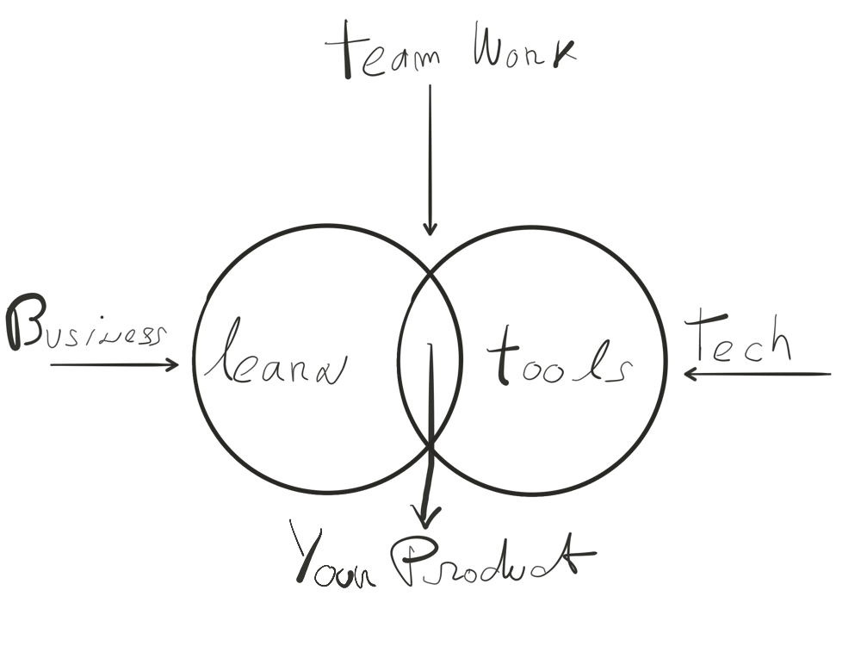

Slide 7
Methodology
Speed Project Management developed by Asst-Prof. Dr. Sergio Coronado
Open Scope Selection
Business Included
Do I find it interesting?
Do I care about it?
They feel the business
Most love it
Continous
Dynamic
Full Commitment
Enjoyment in the work
Weekly follow-up
Coaching
“Flow” Work Assignments
Rhythm
Notes:
Flow is the key

Slide 8
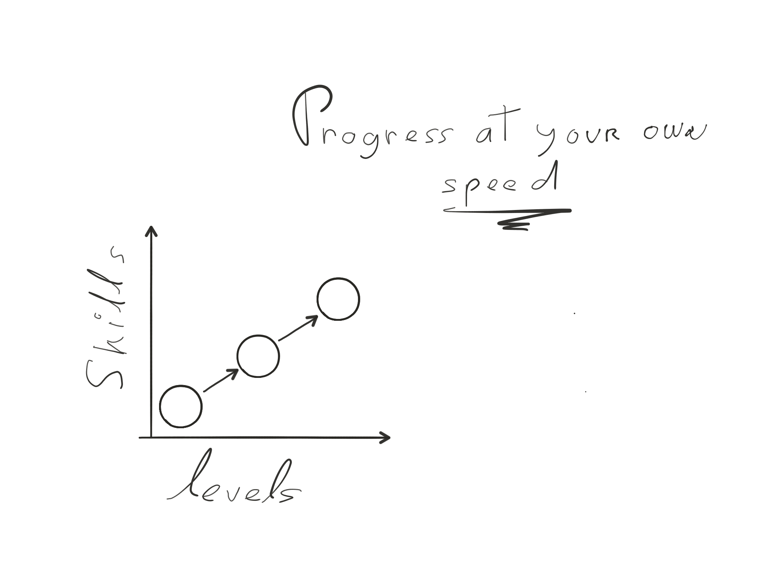

Slide 10
Some numbers on this year LTS
9 fun and serious games developed via open selection process; 5 under publication.
8 Big Data Analysis projects via open selection process; from “inequality in the world” to “UFO sightings”. Project feature at the ICT Spring Gala Dinner in an unique performance based presentation.
+70 classroom sessions delivered so far… carsh session first, “theory” discovery after.
+800 minutes of video classes produced, classroom flipped 100%.

Slide 11
Up coming event(s)
FinTech Event: Banking Applications Hackathon in collaboration with the Luxembourg House of Financial Technology (LHoFT). Weekend event 30th Jun to 2nd July
UX and APIs

Slide 12
LTS 2017-2018
LTS 1 - Geesseknäppchen
LTS 2 - Limpersberg
LTS 3 - Esch-sur-Alzette
One or two groups at each LTS with max 20 students per group.
Minimum 3 coaches per LTS, minimum two coaches from participating schools.
Program: 1st Module Game Development, Modules 2 and 3 from: Big Data and AI, FinTech, Robotics and IoT.
LTS encourage and support the usage of its content and approach at the school curriculum. Requires separate arrangements by school.
The 3 modules rotates between schools, each school host one module.
Selection process – competitive selection:
Headmasters propose students from their schools; registration process open until Friday 2nd June 2017
Online registration at https://goo.gl/forms/NCeUfg1WbwRTqhoq2
LTS selection test on Saturday 17th June. Goal is to select the most suitable students for the program.

Slide 13
Questions?

